Slide 1
Responding to Your Survey Comments
Too easy material
What to cover in class, what not to cover
More practice problems
Quiz on Friday
Ungraded Quiz
2

Slide 2
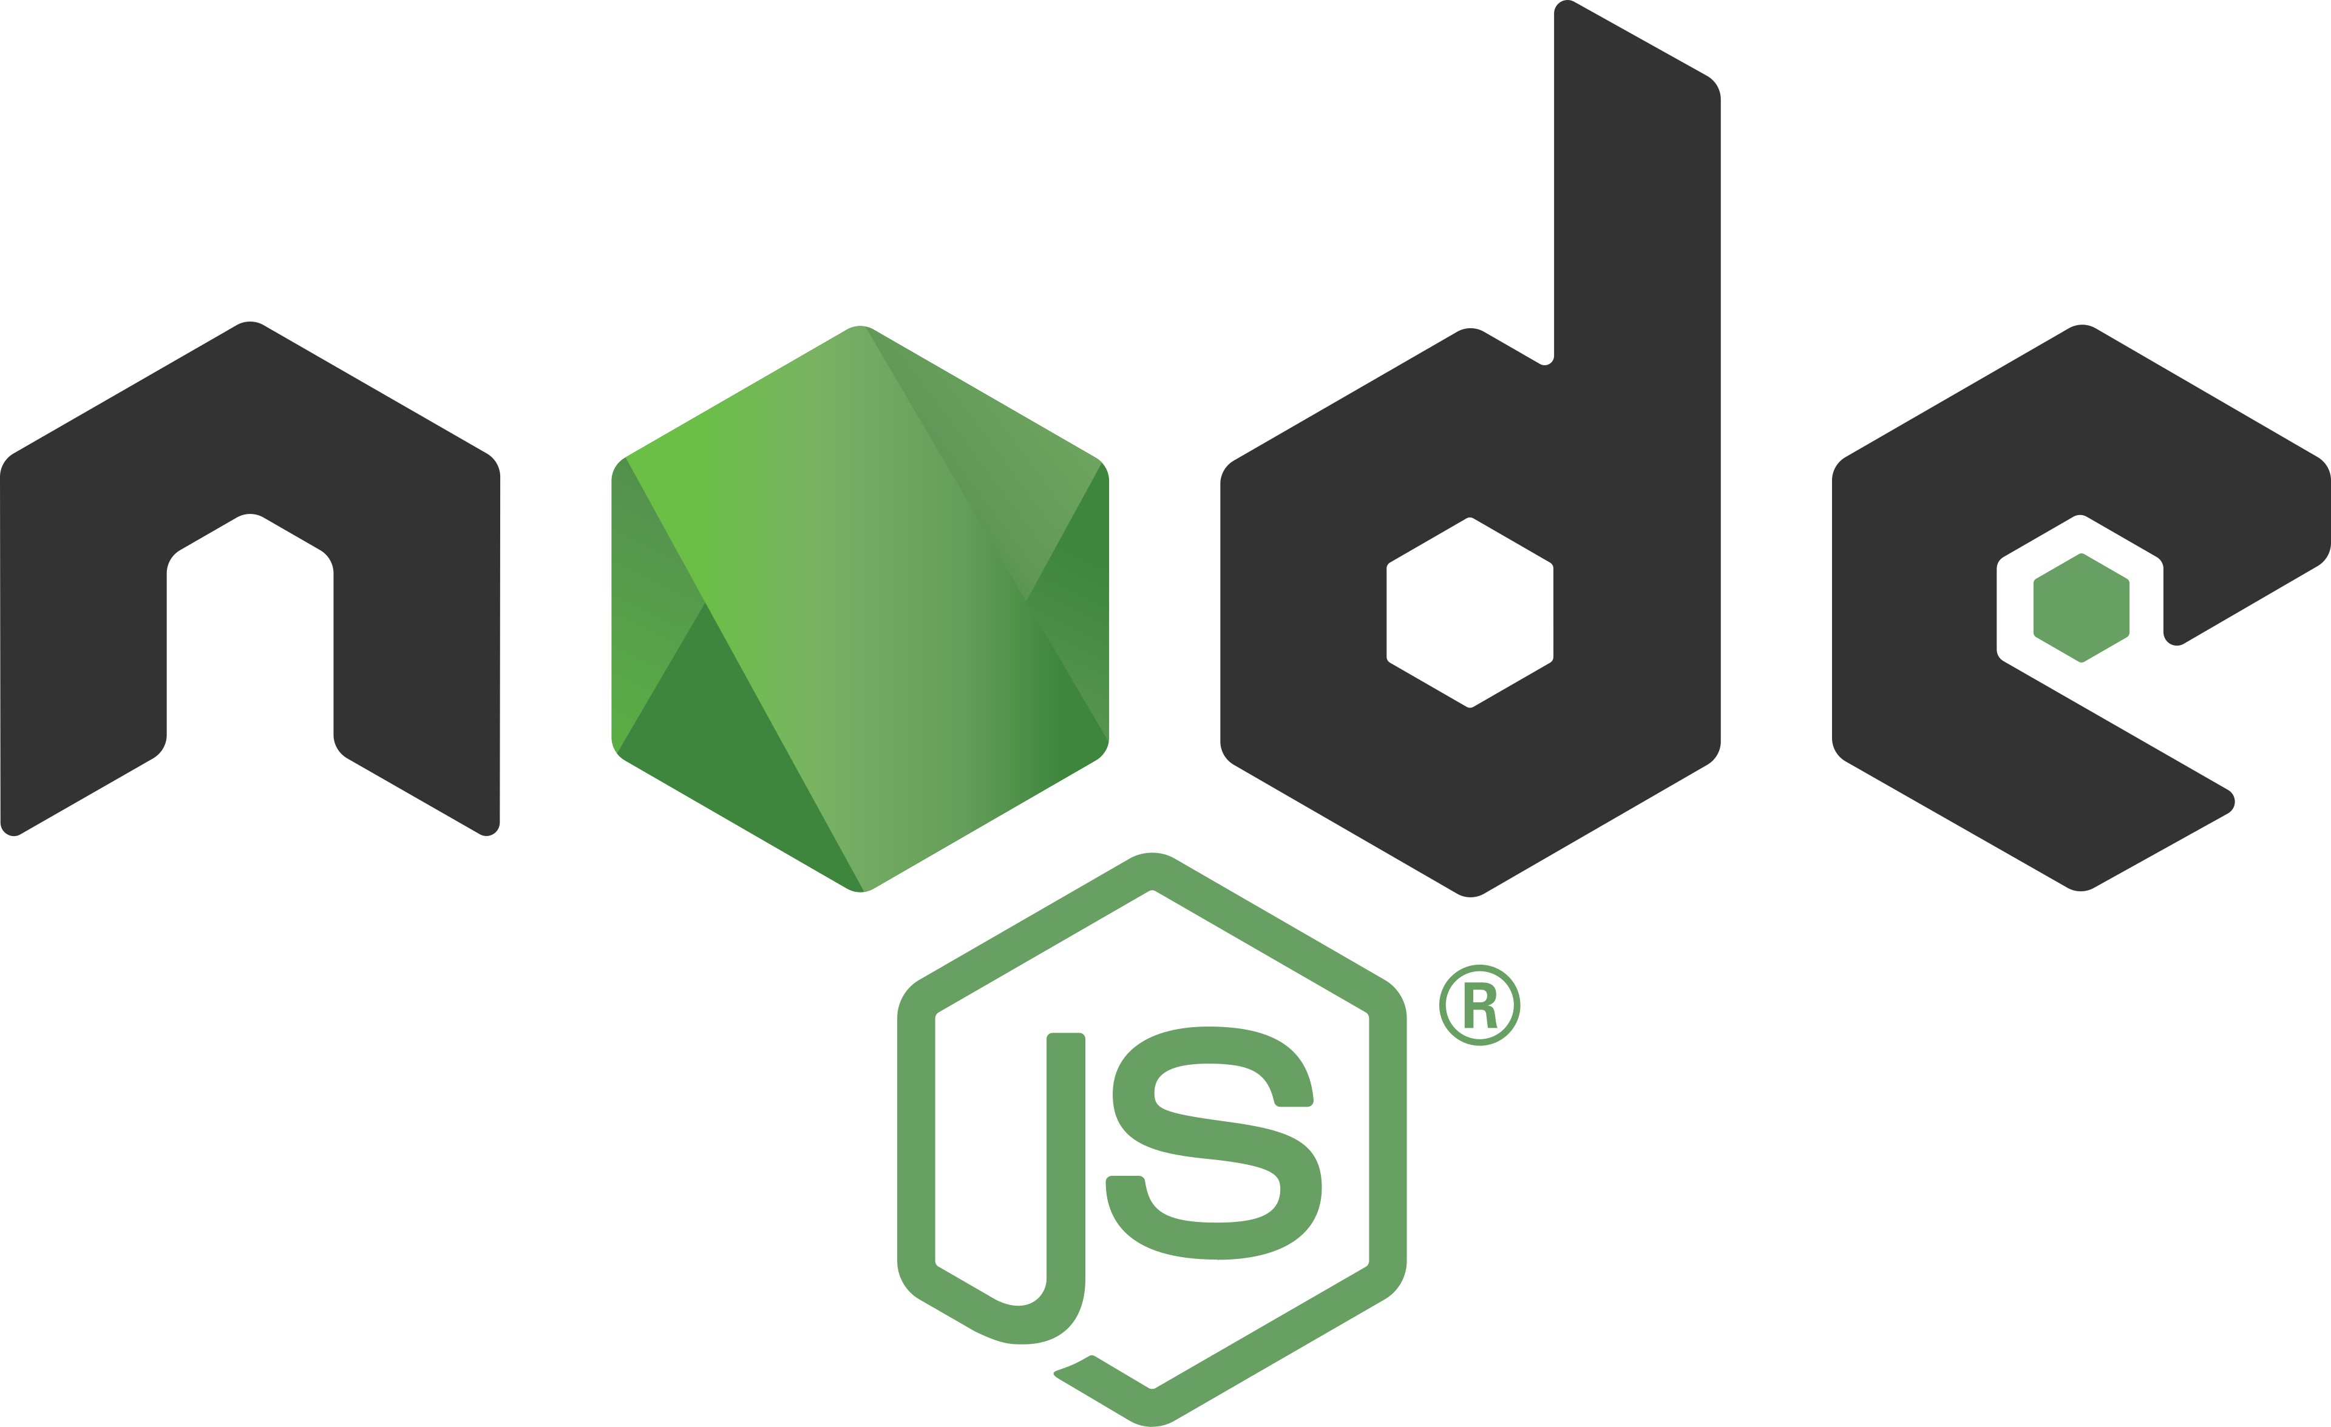
HCDD 411:
Node.js Fundamentals
Md Touhidul Islam
1
Notes:
[Sources] - Node.js logo (Wikimedia Commons): https://commons.wikimedia.org/wiki/File:Node.js_logo.svg [/Sources]

Slide 3
What you’ll be able to do after learning Node.js
Explain where Node.js sits in a client–server architecture (and why we use it)
Write and run Node programs: scripts, REPL, modules, packages
Understand the event loop, async I/O, promises, and async/await
Use core Node modules (fs, path, process, http, URL, streams)
Build a small HTTP API using only Node (before we add Express)
Debug in VS Code, structure projects, and adopt basic best practices
2

Slide 4
1) Why Node.js?
3

Slide 5
What is Node.js?
Node.js® is a free, open-source, cross-platform JavaScript runtime environment.
Browser JS runs inside the browser sandbox (DOM, window, user-driven)
Node runs on your machine / server (file system, network sockets, processes)
Same language as the client → easier full-stack development and shared code
In distributed systems terms: Node is a convenient platform for writing servers that expose remote services (APIs) and coordinate I/O.
4
Notes:
[Sources] - Node.js definition: https://nodejs.org/en [/Sources]

Slide 6
Where Node.js sits in the client–server architecture
Client (Browser)
JS + Fetch/Axios
Network
HTTP(S) Requests
Server (Node.js)
API + Business Logic
Data Store
DB / Cache / Files
Node.js sits on the server side of the client–server architecture.
It receives HTTP requests, runs business logic, and talks to data stores or other services.
5

Slide 7
Why do we need Node.js?
You already know how to call APIs from the client (fetch/axios/AJAX).
Now we learn how to implement the server that receives those calls.
Node gives us: networking + files + processes + a huge ecosystem (npm).
We can build distributed components: API servers, workers, gateways, CLIs.
Mental model: Your client code calls “remote methods”. Node is where those remote methods actually run.
6

Slide 8
When Node.js is a great fit
Many concurrent connections (chat, dashboards, APIs with lots of users)
I/O-bound workloads: DB calls, HTTP calls to other services, file operations
JSON-heavy APIs (web/mobile clients)
Rapid iteration + big ecosystem (middleware, auth, validation, etc.)
7

Slide 9
2) Setup
9

Slide 10
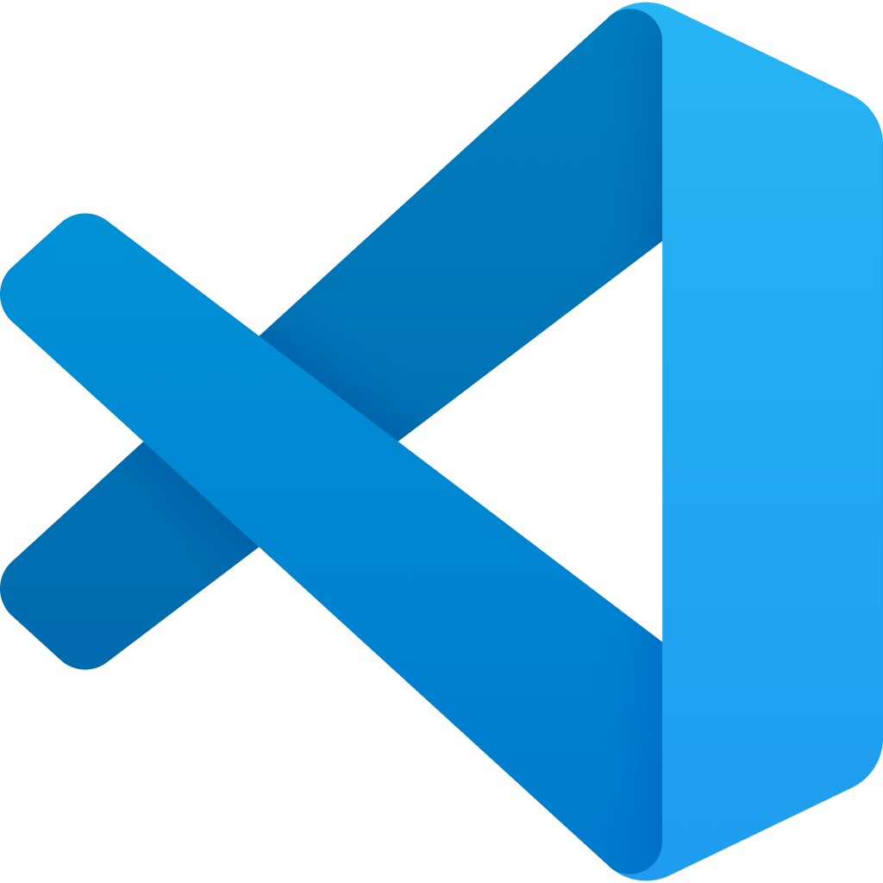
Tools we’ll use
Core:
• Visual Studio Code
• Node.js (LTS recommended)
• npm (bundled with Node)
Optional (but useful):
• nvm / nvm-windows (manage Node versions)
• Git
We’ll write pure Node code first. Express comes later.
10
Notes:
[Sources] - VS Code icon: https://code.visualstudio.com/brand [/Sources]

Slide 11
Install VS Code (quick checklist)
Download from the official site and install.
https://code.visualstudio.com/download
11
Notes:
[Sources] - VS Code download: https://code.visualstudio.com/download - VS Code setup overview: https://code.visualstudio.com/docs/setup/setup-overview [/Sources]

Slide 12
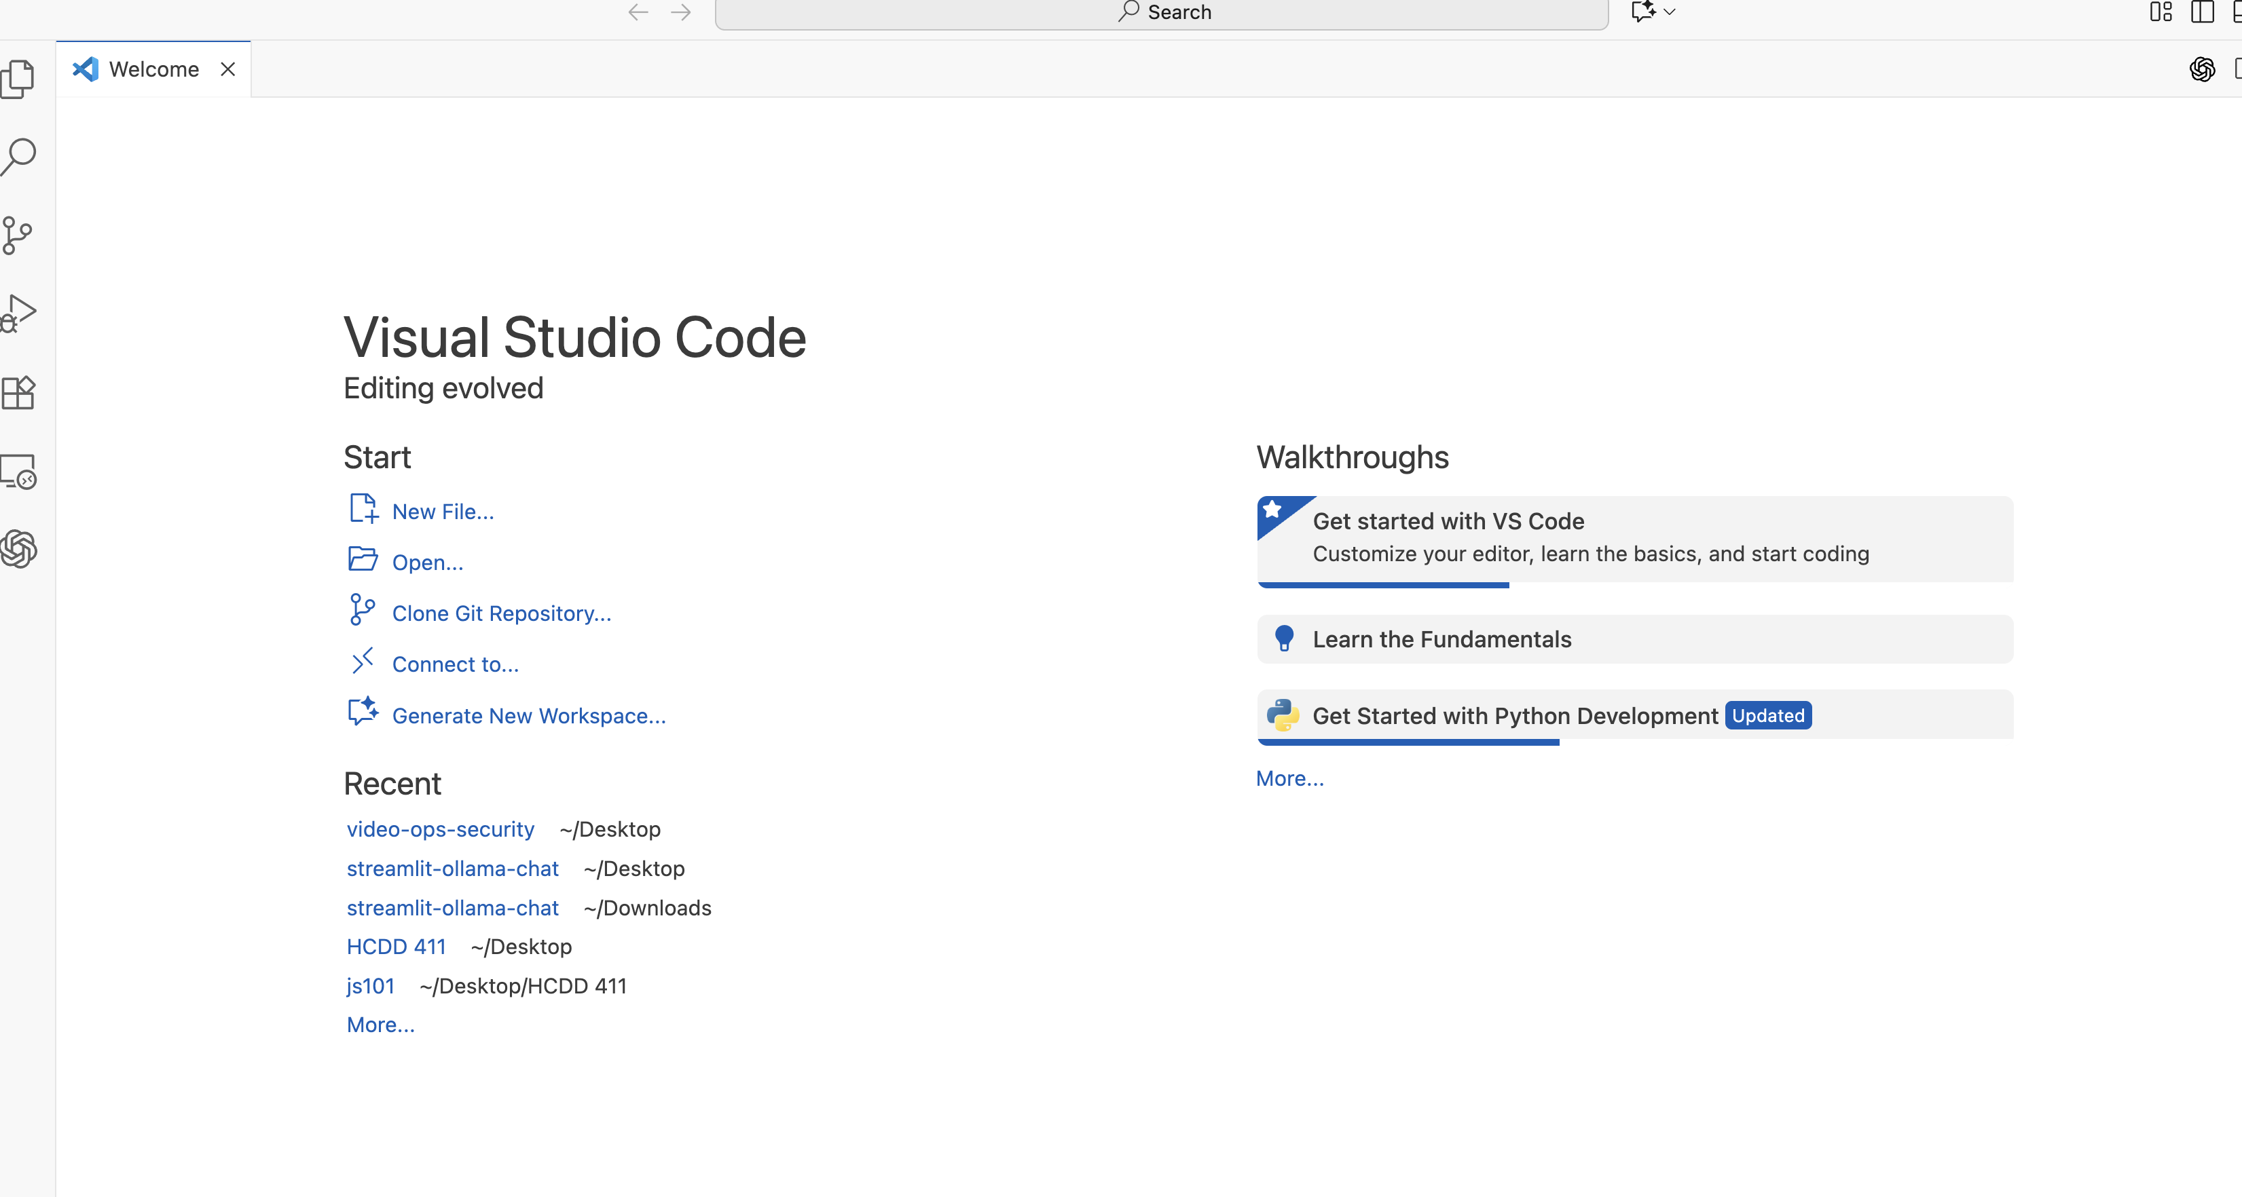

Slide 13
Steps
Create a new folder in your computer, call it nodejs (you can call it something else)
In VS Code’s start window, click open, then select that nodejs folder
Open a new terminal by selecting from options: Terminal -> New Terminal
11
Notes:
[Sources] - VS Code download: https://code.visualstudio.com/download - VS Code setup overview: https://code.visualstudio.com/docs/setup/setup-overview [/Sources]

Slide 14
Install Node.js (LTS)
Install Node.js from the official download page: https://nodejs.org/en/download
Use an LTS version for stability in coursework.
12
Notes:
[Sources] - Node.js releases and LTS status: https://nodejs.org/en/about/previous-releases - Node.js download page: https://nodejs.org/en/download [/Sources]

Slide 15
Verify Installation
After installing, verify node and npm versions.
node -v
# expect something like: v24.x.x (LTS)
npm -v
# show where node lives
where node # Windows
which node # macOS/Linux
12
Notes:
[Sources] - Node.js releases and LTS status: https://nodejs.org/en/about/previous-releases - Node.js download page: https://nodejs.org/en/download [/Sources]

Slide 16
Optional: manage multiple Node versions (nvm)
nvm (macOS/Linux) / nvm-windows lets you install and switch Node versions.
Helps you match project requirements (e.g., “Node 20” vs “Node 24”).
For this course: pick one LTS and stick to it unless told otherwise.
# macOS/Linux examples
node -v
# list installed versions
nvm ls
# install and use a version
nvm install --lts
nvm use --lts
13

Slide 17
3) Running Node
14

Slide 18
Create new .js file
Right click on the file explorer section of VS code, then choose new file
Name it hello.js
12
Notes:
[Sources] - Node.js releases and LTS status: https://nodejs.org/en/about/previous-releases - Node.js download page: https://nodejs.org/en/download [/Sources]

Slide 19
Your first Node program
// hello.js
console.log('Hello from Node!’);
console.log('Node version:', process.version);
# run it
node hello.js
15

Slide 20
Node REPL (interactive console)
REPL = Read–Eval–Print Loop
Type JavaScript expressions and see results immediately
Useful for testing small snippets, regex, JSON transforms, etc.
node
> 2 + 2
4
> const x = {a:1}
undefined
> x
{ a: 1 }
> .exit
16

